Slide 1
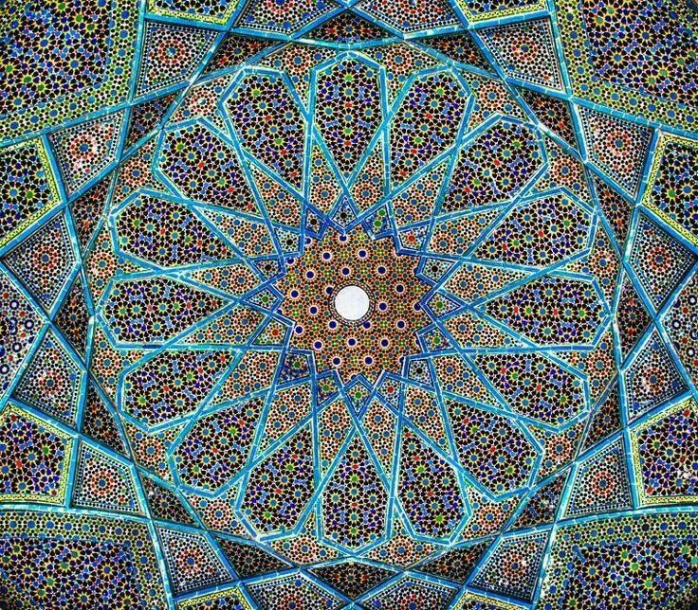
Islamic Theology & Cosmology
www.prshockley.org

Slide 2
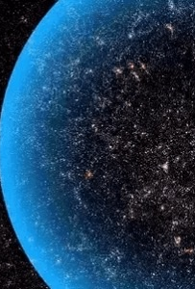
What are we against the backdrop of Infinity?
Consider these words by Blaise Pascal…
When I consider the short duration of my life, swallowed up in an eternity before and after, the little space I fill engulfed in the infinite immensity of spaces whereof I know nothing, and which know nothing of me, I am terrified. The eternal silence of these infinite spaces frightens me…
But it is not from space that I must seek my dignity. I should have no more if I possessed whole worlds. By space the universe encompasses and swallows me as an atom… by thought I comprehend the world.

Slide 3
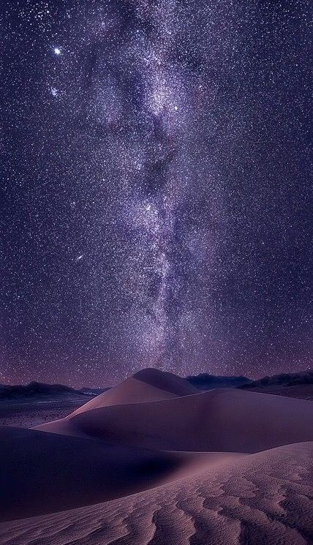
“All men’s miseries derive from not being able to sit in a quiet room alone.”
~ Blaise Pascal

Slide 4
Cosmology and Islamic Art:

Slide 5
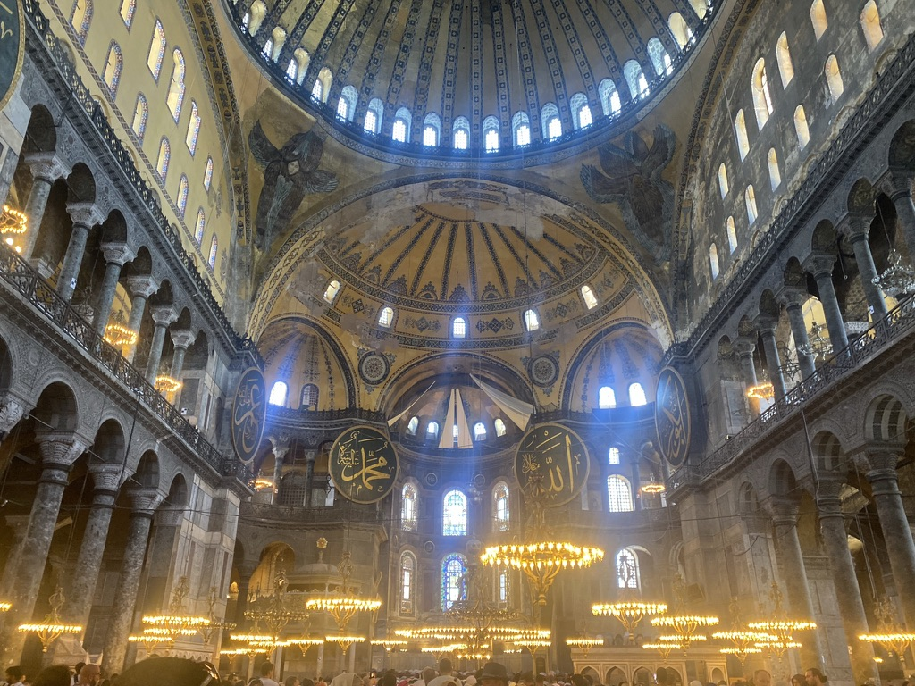
Ethnic & Confessional Worldview
Quran 67:2:
“Allah is He who created death and life to test you as to which of you is best in deed.”

Slide 6
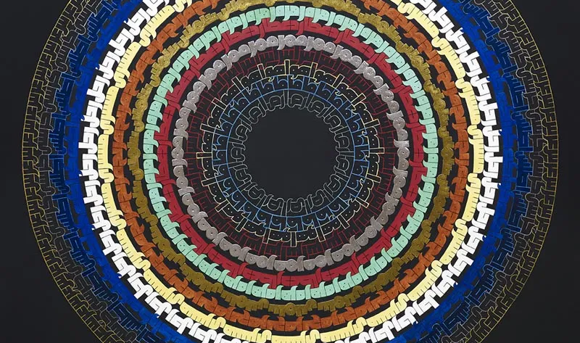
Ethnic:
Islam’s beginnings in the Arabian Peninsula.
Islam is an ethnic religion, comparable to Judaism & Hinduism
Islam espouses a universal teaching but channels it through one group of people, Arabian thought, life, and Arabic language

Slide 7
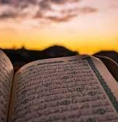
Ethnic: Quran
Arabic is the language of the Qurʾān, (Arabic: “Recitation”). It is also spelled Quran and Koran.
G-d chose Arabic to communicate with an Arab prophet.
The choice of Arabic has meaning for all Muslims, even non-Arabs. For Arabic is not only merely the content of the Qurʾān, but its expression in Arabic embodies the full measure of divine revelation.
Thus, the “Arabicity of the Qurʾān” remains a doctrine in Islam, reinforcing the ethnic Arab character of Muslim belief and ritual.

Slide 8
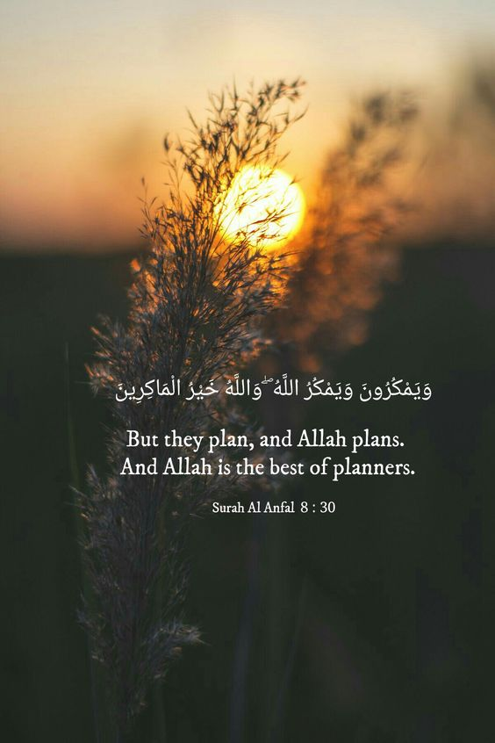
Islam is a confessional religion
Similar to Buddhism and Christianity, Islam faith tradition is universal in doctrine and in evangelism. In other words, Islam is a missionary faith.
Why a missionary faith? Islam promotes conversion to the faith tradition with a universal simple message that can be easily transmitted across cultures, time, history, and space.
Instead of multiple truths to know to become Islamic, there is only absolute:

Slide 9
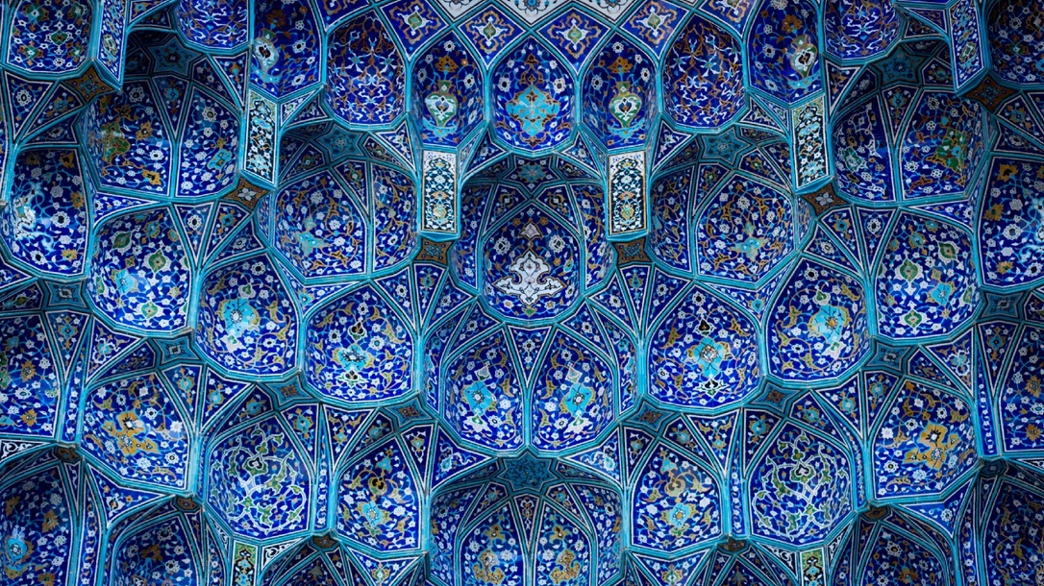
To become a Muslim…
One has only to declare in sincerity and preferably in the presence of a person already professing Islam, “I testify that there is no god but G-d, and that Muhammad is the Prophet of G-d.

Slide 10
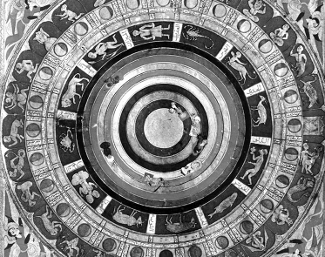
Two Presuppositions of this Creed:
    The invisible includes heaven and hell just as world is called earth
    Creatures whether angels or demons (Jinn) inhabit that world in the same way humans and animals inhabit our planet.

Slide 11
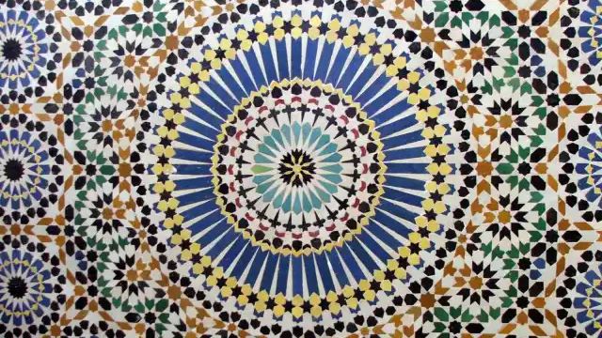
Two Presuppositions of this Creed:
  Purposeful force has created both worlds, that it governs, guides, and ultimately judges. Because the force is all-powerful rather than competitive with others or compromised by their existence, it is singular (essence) G-d, not plural (gods).
  Absolute rejection of polytheism in favor of monotheism. It underlies the pivotal Muslim doctrine of divine unity (Tawhid) and has its historical roots in Judaism and Christianity.

Slide 12
Transcendent Oneness
  which Islam isolates as the fundamental force of the universe is only knowable through human prophets (Nabi).
  Muhammad is one of their number. He is G-d’s messenger to (Rasul) to the Arabs, as Moses was to the Jews, Jesus to the Christians, and Zoroaster to the Zoroastrians.

Slide 13
